Slide 1
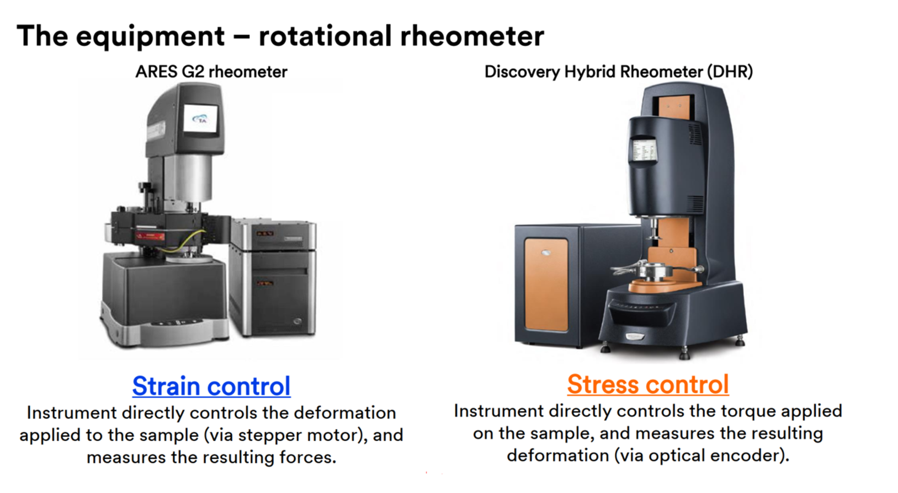
Rheology data –Option 1

Slide 2
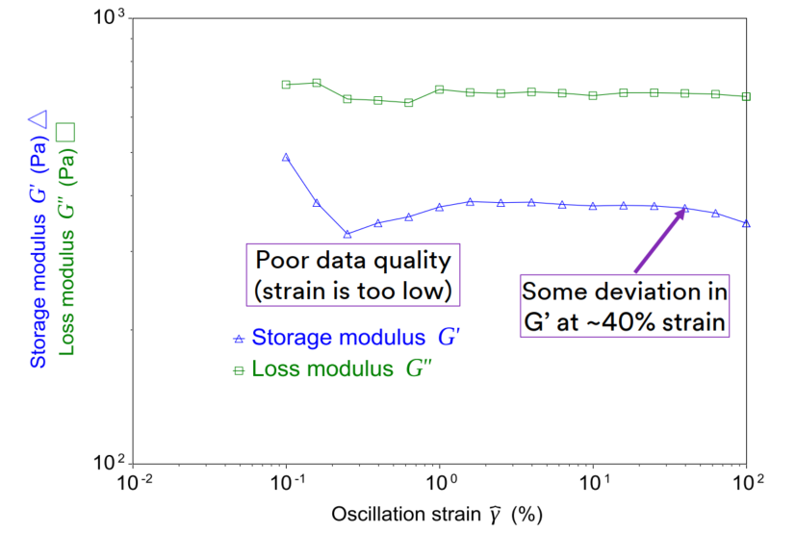
Rheology data –Option 1
Polymer system at 140 C

Slide 3
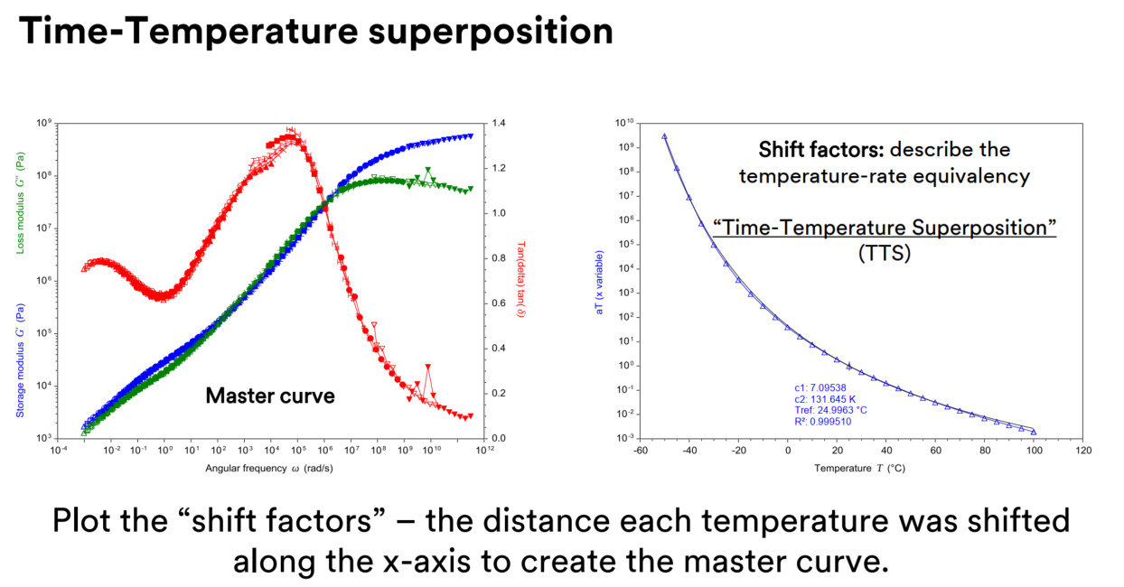
Rheology data –Option 1

Slide 4
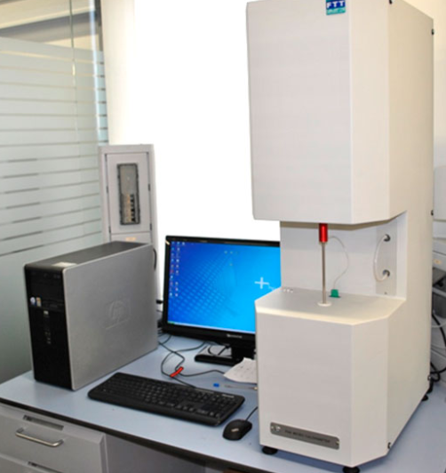
Micro-combustion Calorimeter (MCC)data –Option 2

Slide 5
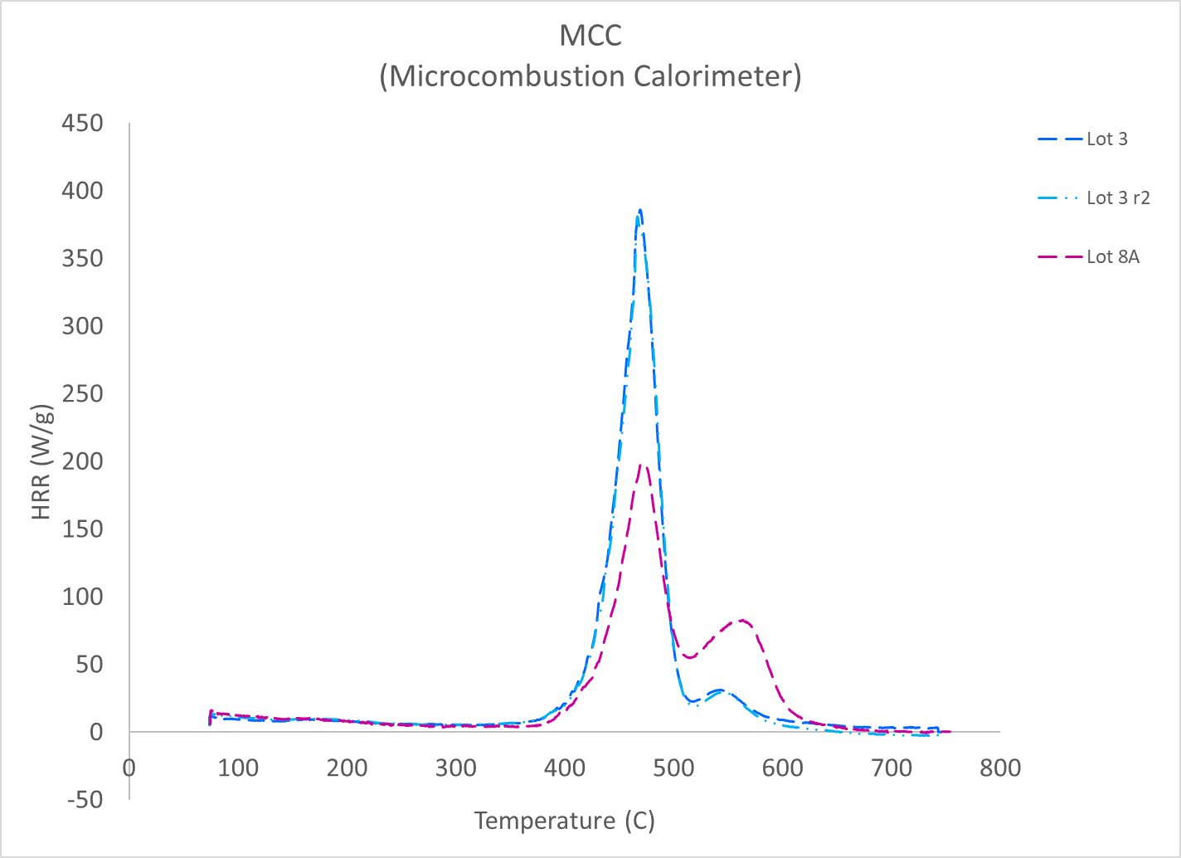
Micro-combustion Calorimeter (MCC)data –Option 2

